Slide 1
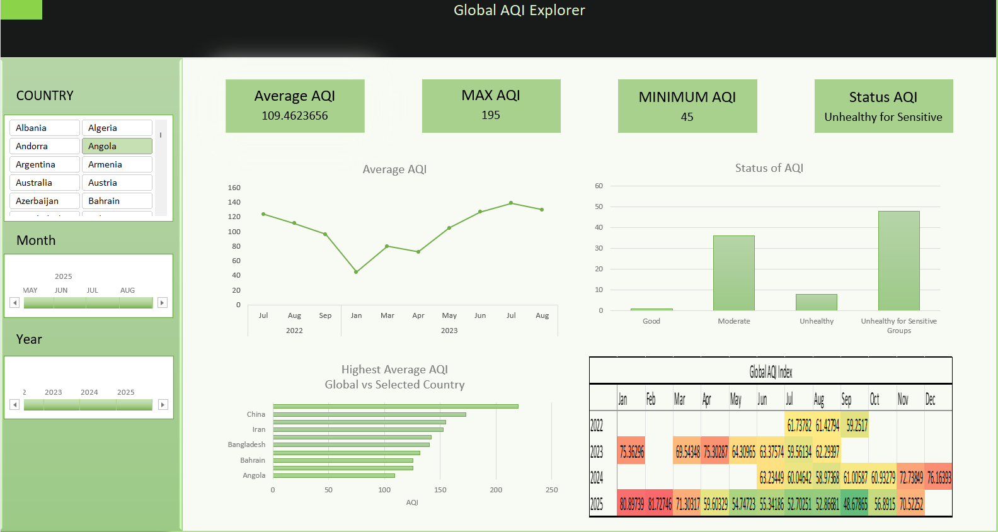

Slide 2
Global Air Quality Index
Excel Dashboard & Exploratory Analysis
Data period: 21 Jul 2022 – 06 Nov 2025 • 142 countries • 21,964 observations

Slide 3
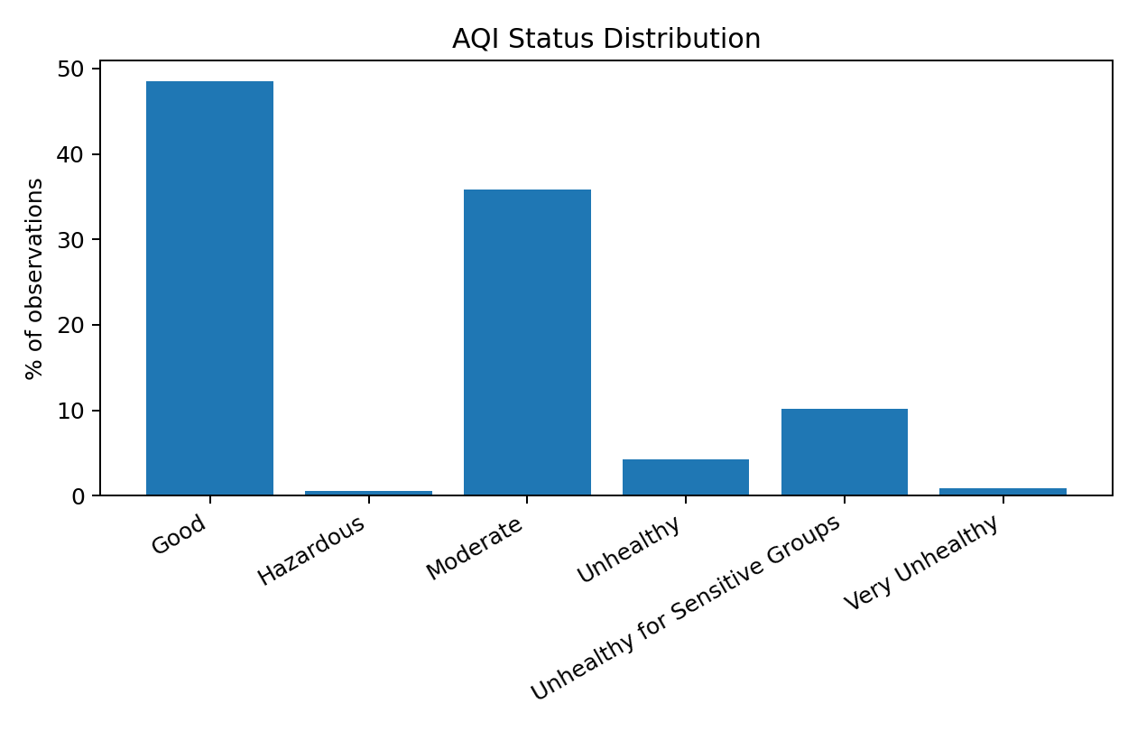
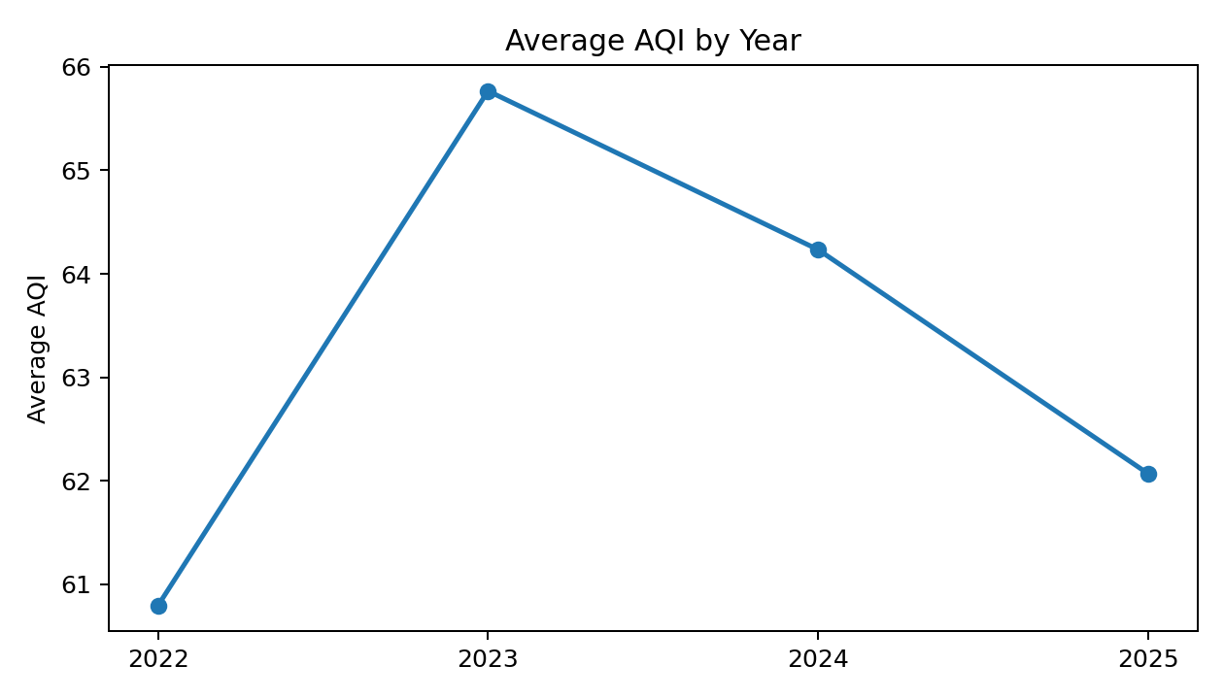
Dataset at a glance
The workbook combines a raw observation table with Excel dashboard/pivot content.
Observations
Countries
Average AQI
Peak AQI
21,964
142
62.4
963

Slide 4
What the status distribution shows
48.5% of observations are classified as Good.
35.8% fall into Moderate air quality.
15.8% are at least Unhealthy for Sensitive Groups.
Hazardous observations account for 0.5%, but extreme AQI spikes materially affect the maximum.

Slide 5
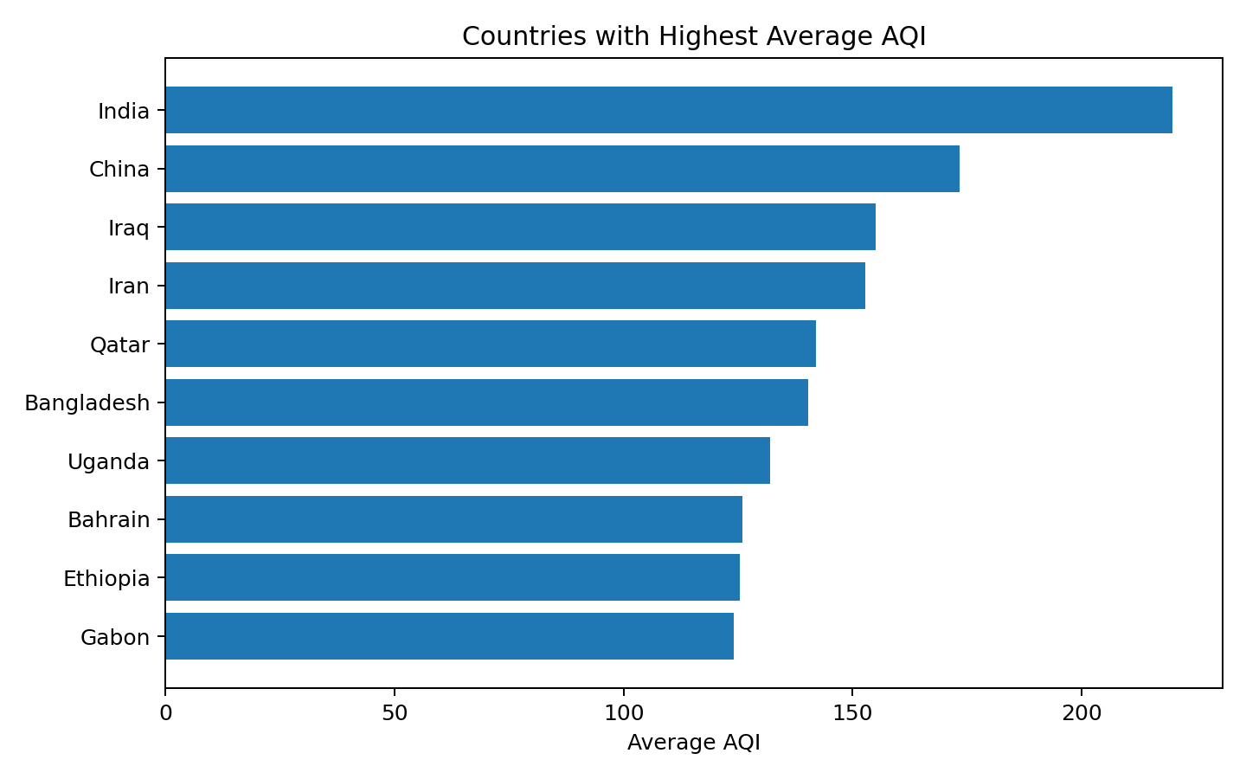
Country-level variation
Average AQI varies sharply across countries in the dataset.
Highest average AQI: India (219.8).
China follows at 173.3, then Iraq (155.1) and Iran (152.9).
Among the lowest averages: Guam (3.1), Cayman Islands (10.4), and Brunei (11.7).
Peak observations reach 963 in China and 946 in India.

Slide 6
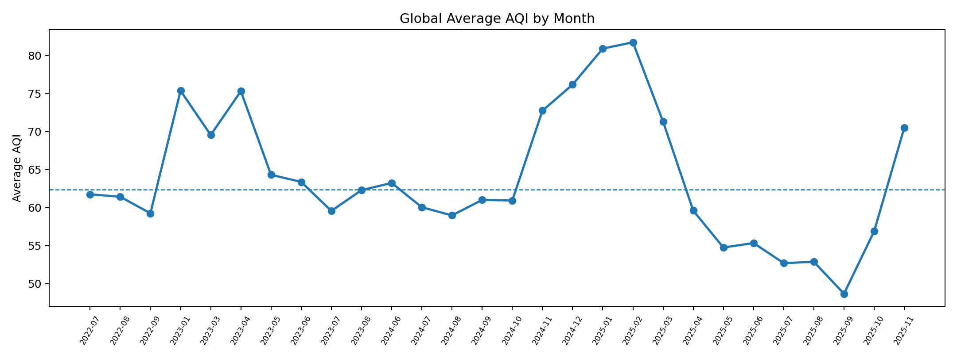
Temporal pattern
The dataset shows recurring periods of higher global-average AQI, especially around winter 2024–25.
Highest monthly averages: Feb 2025 (81.7), Jan 2025 (80.9), Dec 2024 (76.2). Lowest months cluster around mid/late 2025.

Slide 7
Dashboard experience
The Excel dashboard turns the raw observation table into an interactive global AQI explorer.
Avg AQI
Max AQI
Countries
Records
62.4
963
142
21,964

Slide 8
Key takeaways & limitations
01
Air quality is highly heterogeneous.
Country averages and extremes differ by an order of magnitude, so a single global average hides important local variation.
02
Seasonality is visible.
The highest global-average months in this dataset occur around Dec 2024–Feb 2025.
03
Extreme episodes matter.
Averages are sensitive to spikes; maximum AQI reaches 963, indicating severe episodic pollution in some observations.
04
Interpretation needs context.
The workbook is an AQI observation dataset, not a causal study. Country coverage is uneven, and AQI scales/data provenance should be documented before comparing jurisdictions directly.

Slide 9
Project links
GitHub Repository
https://github.com/Er-Rajas/AQI-excel-dashboard
Includes the Excel workbook and project documentation.

